Slide 1
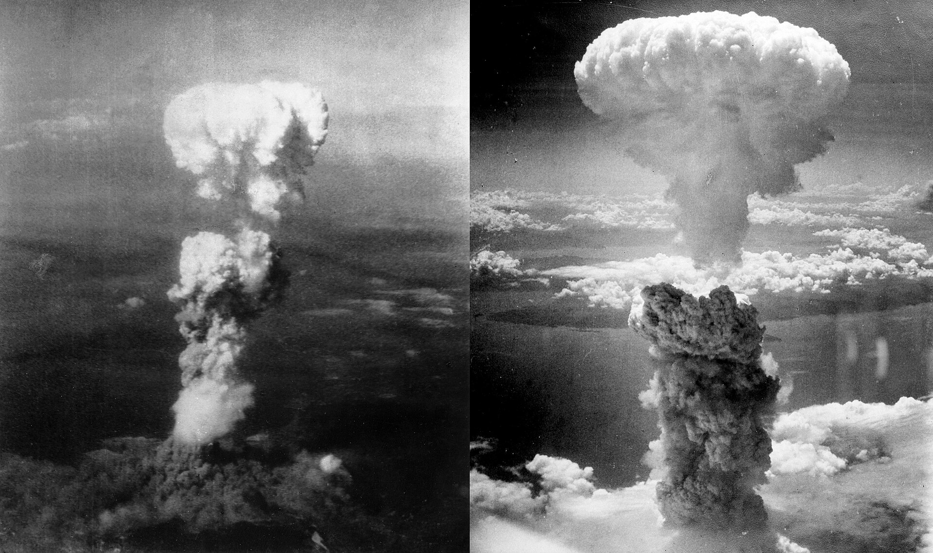
The Atomic bombings of Hiroshima and Nagasaki

Slide 2

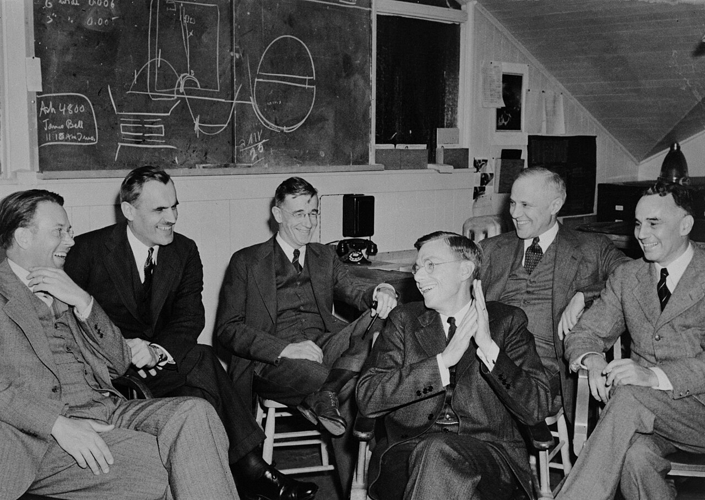
The project responsible for developing the atomic bomb was called the Manhattan project, which costed 2 billion dollars back then, which would today be 30 billion, over 130000 people worked on the project.
Thousands of scientists and engineers worked on the project, but Robert Oppenheimer is considered to be the father of the Atomic bomb.
The scientists first conceptualized a bomb that would utilize nuclear fission.
There was a fear that the atomic bomb could ignite the whole atmosphere and destroy the world, but they still dropped it anyway.
The project was created due to fears that a German atomic bomb project would develop atomic weapons first.

Slide 3
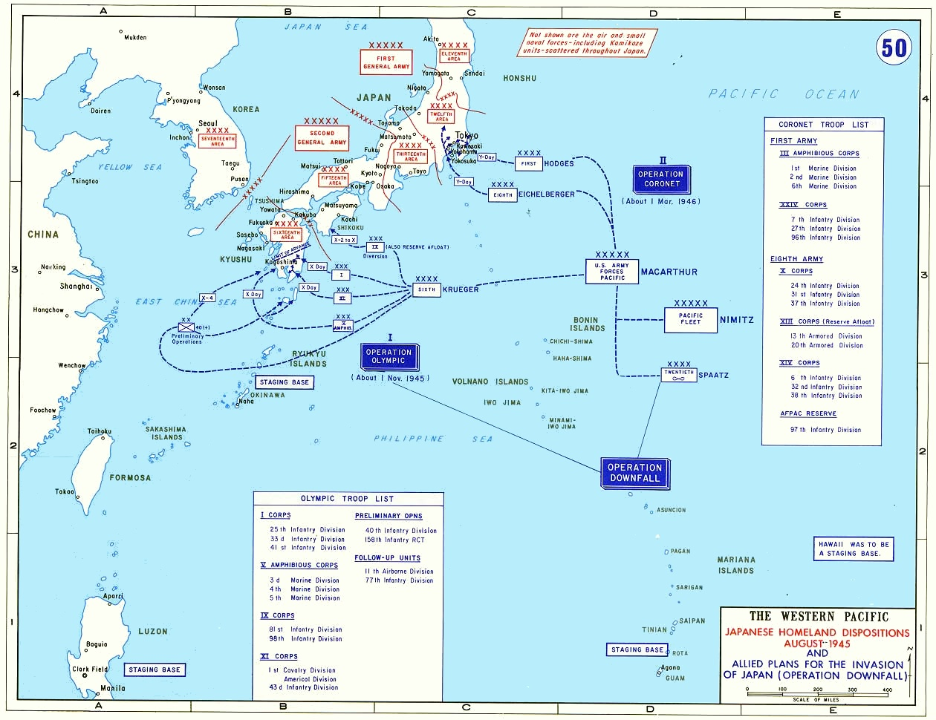
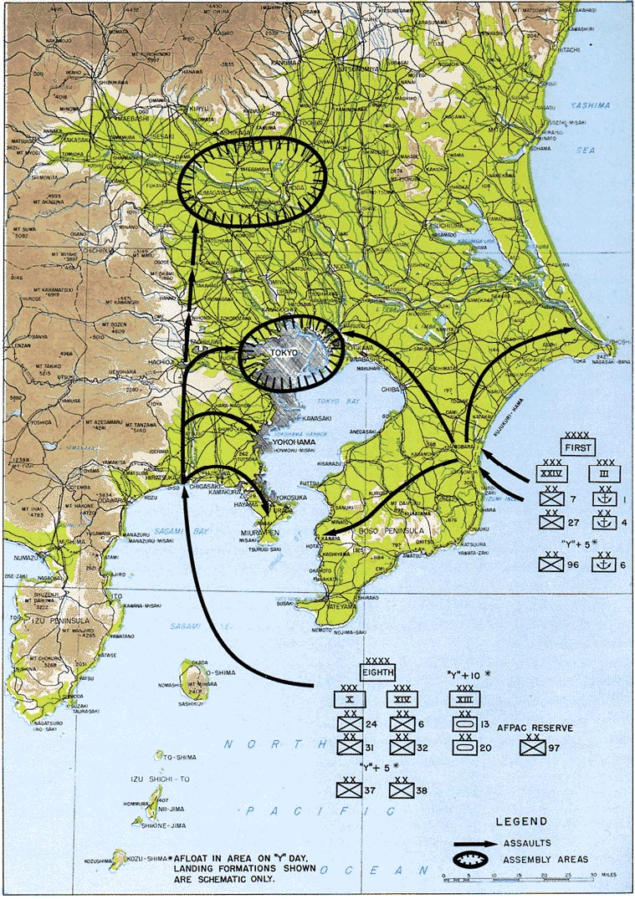
Operation Coronet (*1946)(25)D(12)
The Allied nations had a plan to invade mainland Japan called Operation Downfall, but it was never executed.
Operation Downfall would've likely had casualties numbering in the millions for both sides.
Dropping the atomic bombs would accomplish at least 3 thing:
Shock the Japanese people into unconditional surrender.
Demonstrate military superiority, particularly to the Soviet Union.
The United States Army Air Forces wanted to use its fission bombs on previously undamaged cities to get have accurate data on nuclear-caused damage

Slide 4
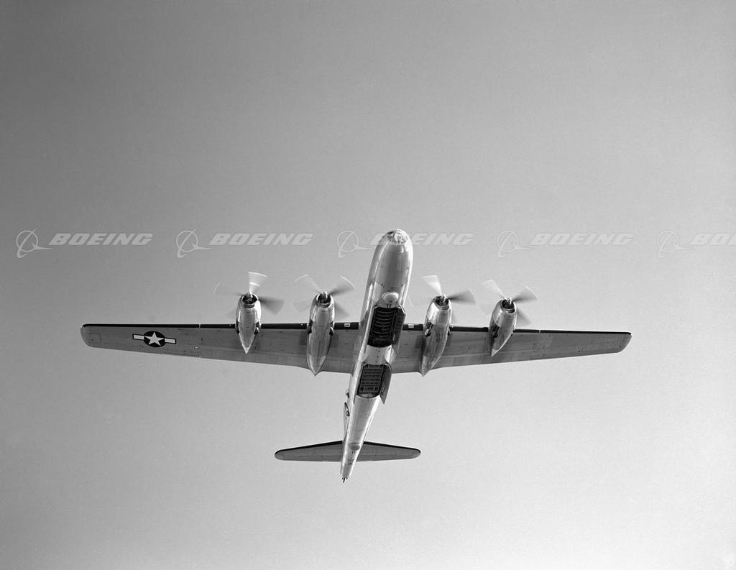
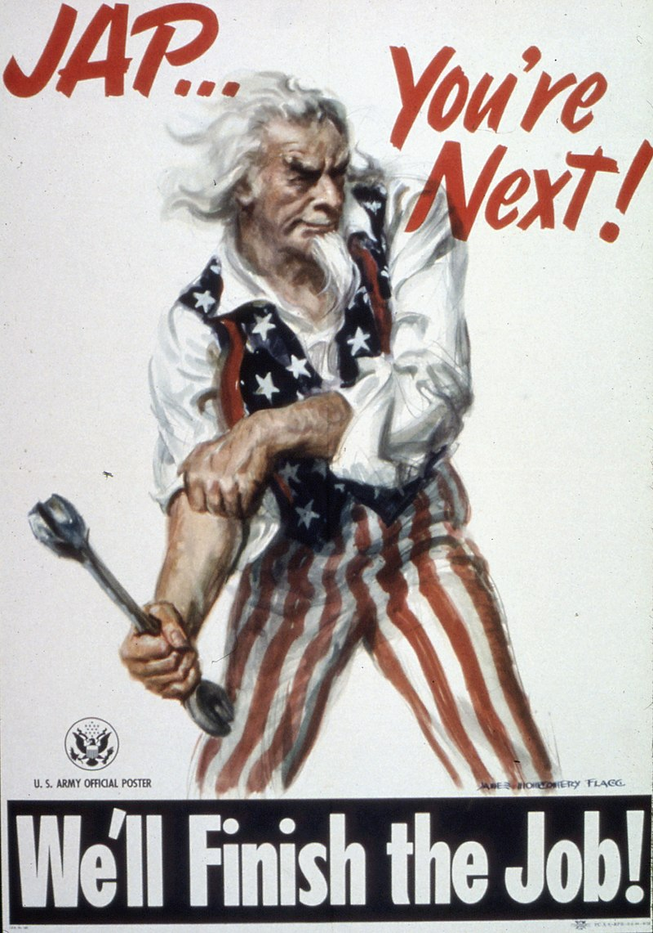
The first aircraft chosen for dropping the bombs was the British Avro Lancaster, because it was the only one capable of carrying the Thin Man and Fat Man, but the American B-29 was chosen instead because there would've been difficulties with maintenance, but it had to be modified.
Its four 3.7 m bomb bay doors and the fuselage section between the bays were removed and a single 10 m bomb bay was configured.
It was decided that "the bomb should be used against Japan as soon as possible; that it be used on a war plant surrounded by workers' homes; and that it be used without prior warning".
The operational plan was to drop the first bomb on 2 August, the second bomb on 10 August, and a third bomb around 24 August. However, due to weather conditions over Japan and the desire for visual bombing, the date of the first bombing mission was pushed back to 6 August, and the second was moved forward to 9 August

Slide 5
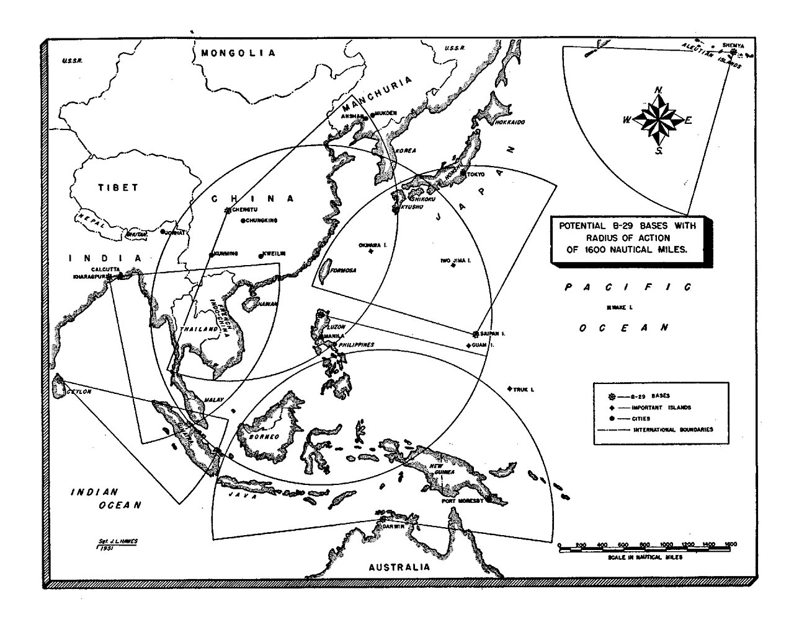
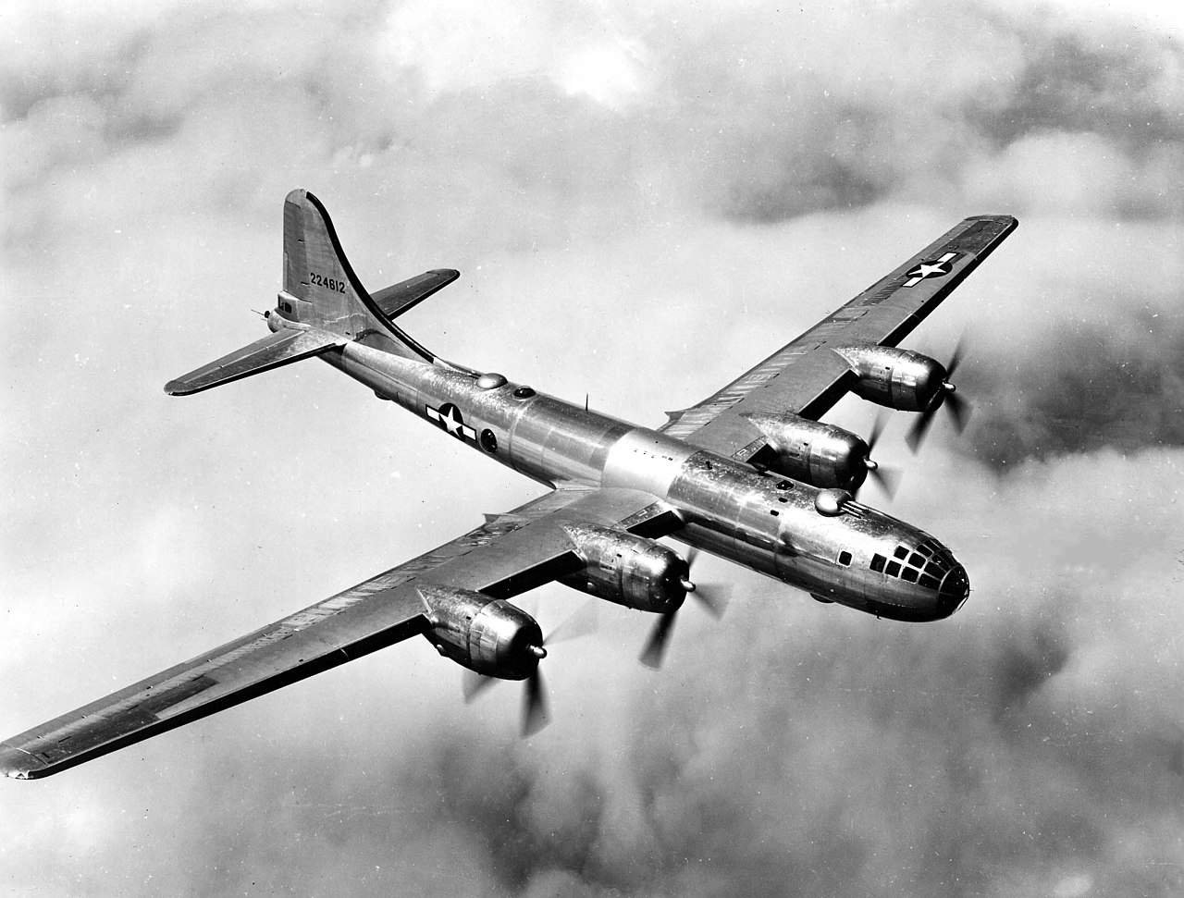
B-29 Superfortress had 4 propeller engines, pressurized cabin, dual-wheeled tricycle landing gear, and an analog computer-controlled fire-control system that allowed one gunner and a fire-control officer to direct four remote machine gun turrets.
designed for high-altitude strat bombing, but also for low-altitude night incendiary bombing(fire bombing), and in dropping naval mines.
It is the only aircraft to ever drop nuclear weapons in combat for now.
Design and production costed 3 billion (52), in comparison the Manhattan project was only 1,9 billion, making it the most expensive program of the war.
It was retired in the early 1960s after 3970 had been built.
The Soviet Union reverse engineered the B-29 and created the Tupolev Tu-4
It was capable of flight at altitudes up to 31850 feet (9710 m), at speeds of up to 350 mph (560 km/h; 300 kn)

Slide 6
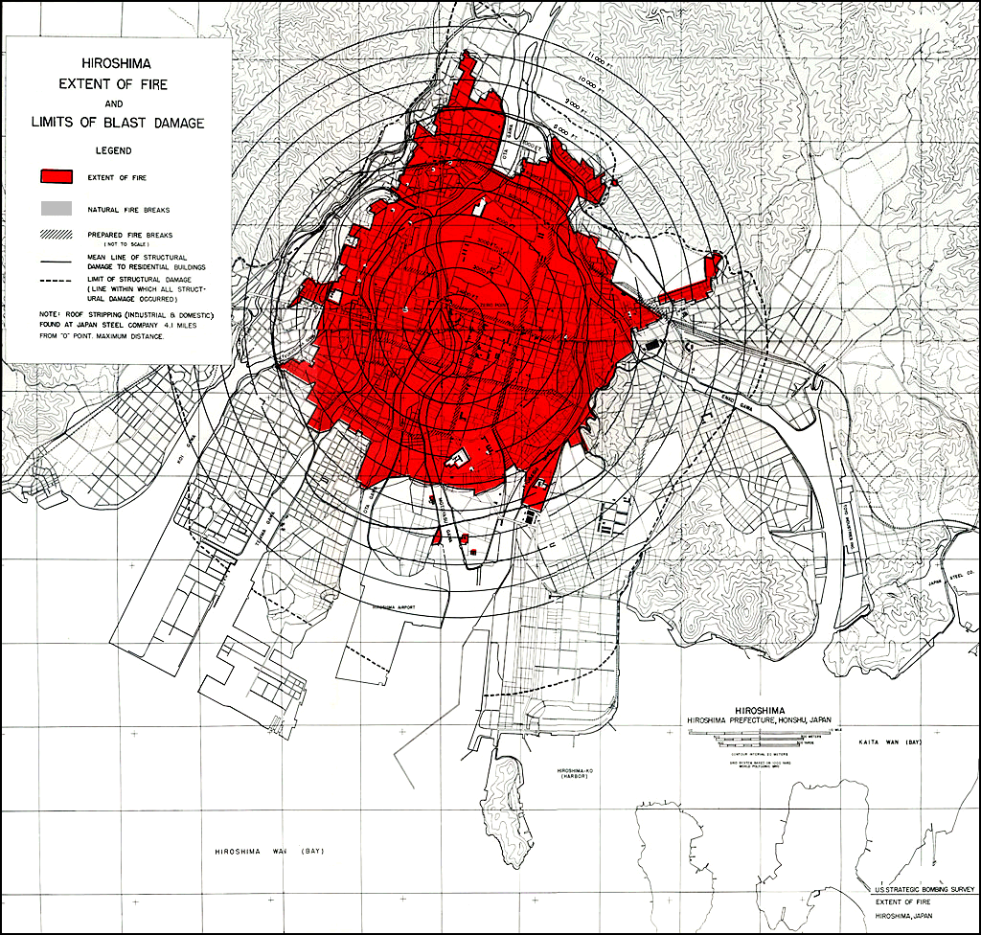
The bombing of Hiroshima, performed on 6th August 1945 by the Enola Gay, a Boeing B-29 Superfortress of the 393rd Bombardment Squadron from the 509th Composite Group, piloted by Paul Tibbets, lifted off from North Field, Tinian with Little Boy.
Hiroshima was the main target, Nagasaki and Kokura were alternatives.
William Sterling Parsons, the weaponeer in charge of the mission, completed the bomb assembly in the air.
At 08:15 the bomb was dropped, detonating at an altitude of 530 m, the blast was later estimated to 13 kilotons of TNT.
12 km² was destroyed. Japanese officials determined that 69% of Hiroshima's buildings were destroyed and another 6–7% damaged.
140000 dead.

Slide 7
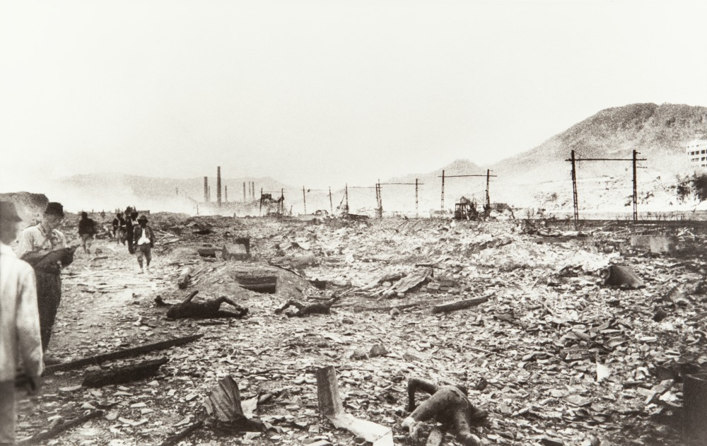
The bombing of Nagasaki, performed by another B-29, "Bockscar", flown by Major Charles W. Sweeney carrying the Fat Man was executed on 9th August 1945.
Ashworth served as weaponeer and Kokura was the primary target, but cloud cover had obscured the city, prohibiting the visual attack required by orders, so they headed for the secondary target, Nagasaki, but even then there was clouds over Nagasaki until last minute.
At 11:02 AM Fat Man was dropped
over the city's industrial valley.
The blast yield was 21 kilotons of
TNT, but was confined to the
Urakami Valley, and a major portion
of the city was unscathed.
44% of city destroyed,
35000–40000 dead, 60000 injured

Slide 8
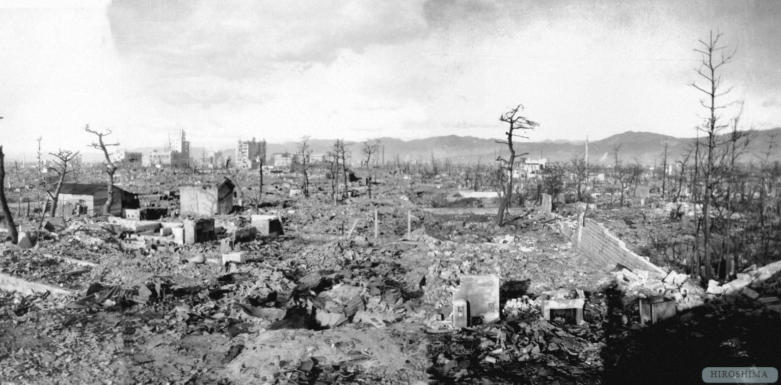
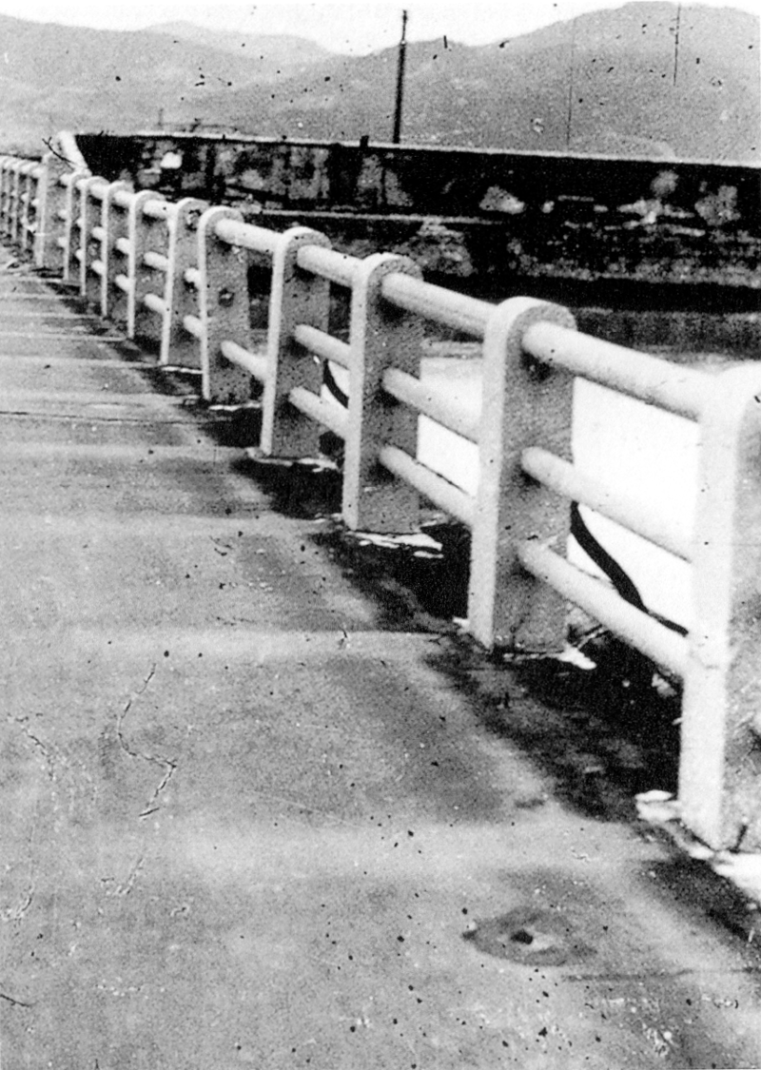
Most accounts of survivors on the ground are: There was a bright flash followed by a loud boom. Most people thought that a regular bomb had gone off immediately in their vicinity, because of the violent damaged they experienced (being thrown across rooms, breaking glass, collapsing buildings), but they would emerge from the rubble and realize that the entire city is in ruins, so they would walk around without knowing where to go and encountering the cries of people trapped within crushed structures, or people with horrific burns.
The bombs created many small fires, which merged into a firestorm, so many people jumped into rivers to escape, but many also drowned.
The fires created by the detonation carried large amounts of ash into the clouds in the atmosphere and 1-2 hours after the explosion, black rain started to fall, which was a combination of ash, radioactive fallout, and water.
Many people also appeared uninjured, but would die within hours or days from radiation sickness.
Communication was lost with rest of Japan and Tokyo learned that the city had been destroyed by a new type of bomb from President Truman's announcement of the strike, sixteen hours later.

Slide 9
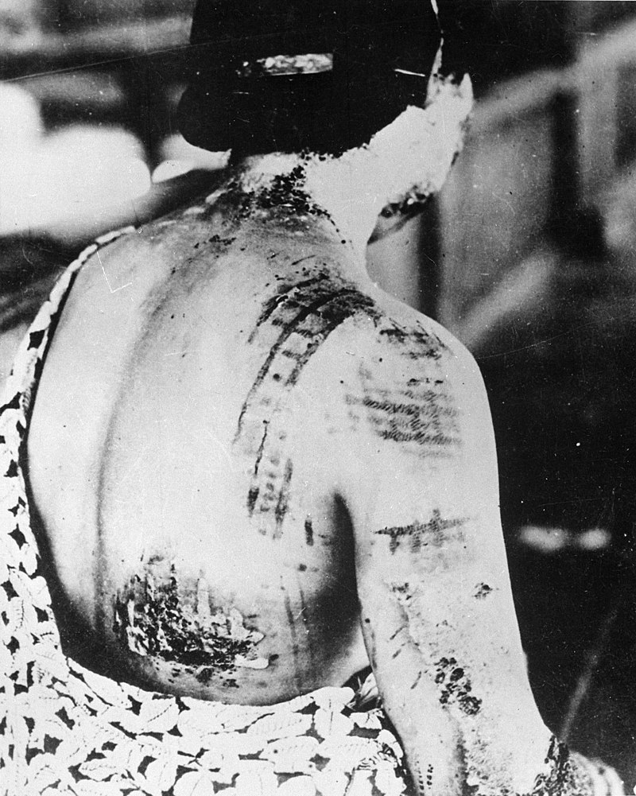
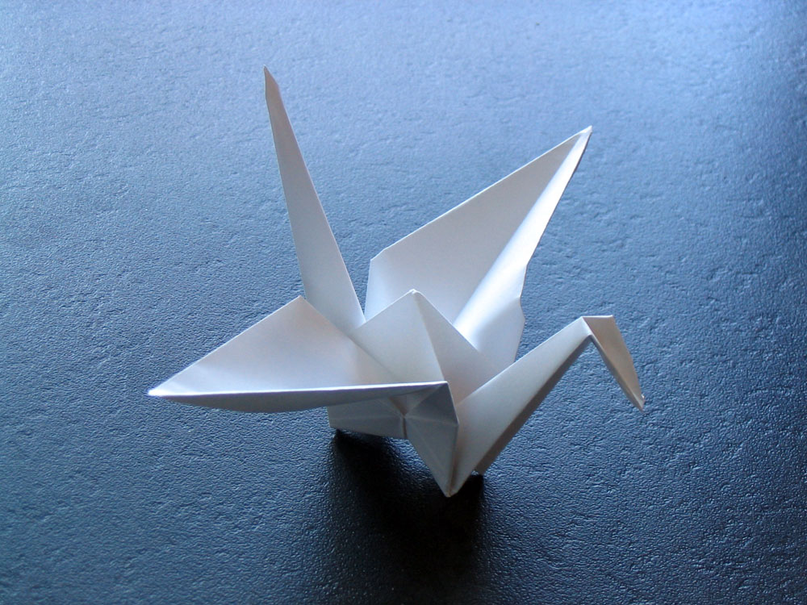
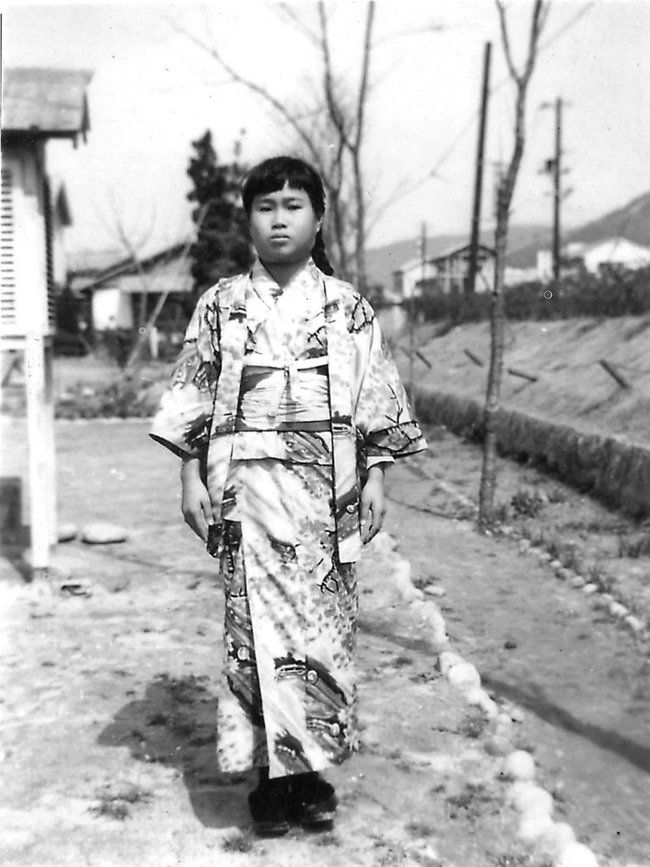
People affected by the atomic bombings were called Hibakusha.
They are considered those who survived the blast, but were still affected by radiation sickness.
They were very discriminated against.
Sadako Sasaki was 2 years old when the bombs fell, she was living near the epicenter and she died two months before her 13th birthday from leukemia.
In Japanese legend, if you fold 1000 paper cranes in one year, your wish will be granted, she tried to achieve that goal, so the paper crane became the worldwide symbol for peace.

Slide 10
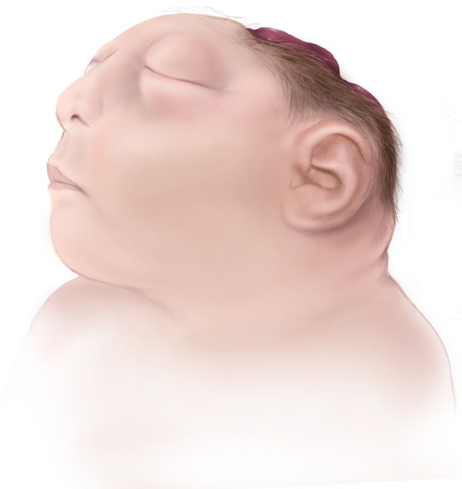
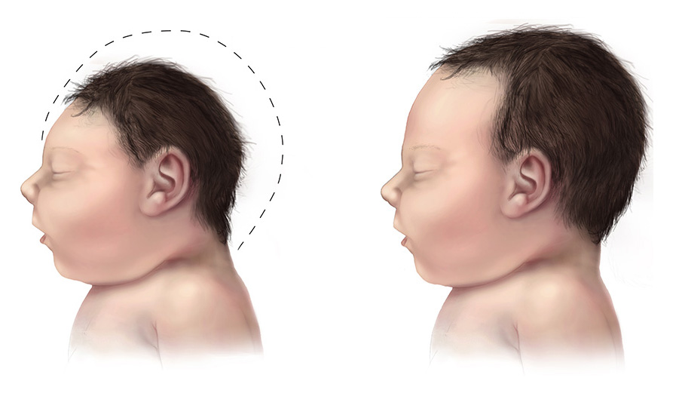
Emperor Hirohito recorded the capitulation announcement on 14th August, which was broadcast the next day.
A coup d'état was attempted by militarists who wanted to continue the war.
Radiation exposure increases cancer risk, but also the average lifespan of survivors was reduced by only a few months compared to those not exposed to radiation
James V. Neel led a study which found that the overall number of birth defects was not much higher among the children of survivors who were pregnant. He also studied the longevity of the children who survived the bombings of Hiroshima and Nagasaki, reporting that between 90 and 95 percent were still living 50 years later. For people in 1 km to the epicenter, an increase in microencephaly(small head) and anencephaly(missing skull) was observed upon birth.

